Slide 1
Physical Security Description
To address the threats, vulnerabilities, and countermeasures
Which can be utilized to physically protect an enterprise’s resources and sensitive information
Including people, facilities, data, equipment, support systems, media, and supplies
To discuss considerations for choosing
A secure site, its design and configuration
The methods for securing the facility against unauthorized access, theft of equipment and information
The environmental and safety measures needed to protect people, the facility, and its resources

Slide 2
Physical Security Threats
Natural / environmental
Earthquakes, Rain, Floods, Mudslides
Tornados, Hurricanes, Tsunami
Insect Damage, Materials Degradation
Heat, Humidity, Moisture
Supply systems
Communication Outages
Power Distribution
Bursting Pipes
Gas Leaks

Slide 3
Physical Security Threats
Man-made
Sabotage / Fraud
Mistakes, Disgruntled Workers
Chemical Spills, Explosions
Construction Failures / Building Collapse
Political Events
Bombings, Terrorist Attacks, Civil Disturbances, Strikes, Espionage

Slide 4
Designing a Physical Security Program
Deterrence
Fences, warning signs, guards, dogs
Detection
Intruder sensors, video surveillance
Delay tactics
Locks, access controls
Situational Assessments
Guard procedures, call trees
Response to intrusions/disruptions
Response team/procedures, authorities

Slide 5
Crime Prevention through Environmental Design (CPTED)
Physical Environment of a building can be managed to produce behavioral effects that reduce the incidence of crime
Territoriality Reinforcement: People protect territory that they feel they own and respect territory of others
Natural Surveillance: Intruders do not want to be seen
Natural Access Control: Properly located entrances, exits, and landscaping can control flow of people and help identify intruders

Slide 6
Facility Planning
“Low visibility”
Surrounding terrain
Building markings and signs
Neighborhood
Surrounding area and external entities
Crime Rate
Proximity to Police/Fire/Medical
Possible hazards from surrounding areas

Slide 7
Facility Planning
Accessibility
Road access
Traffic
Proximity to airports, train stations, and highways
Natural Disasters
Likelihood of floods, tornados, earthquakes, or hurricanes
Hazardous terrain

Slide 8
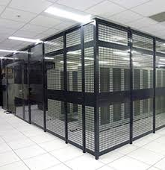
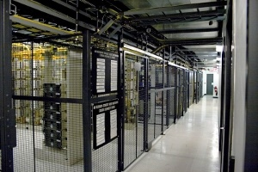
Data Center Cage Examples

Slide 9
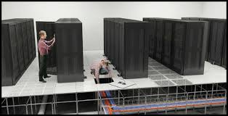
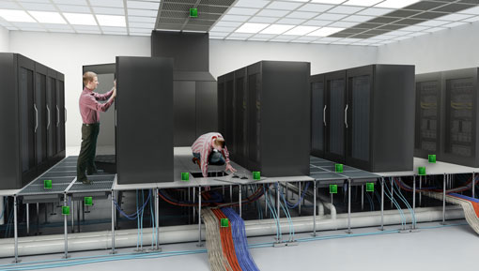
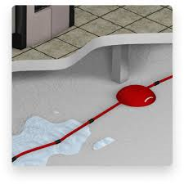
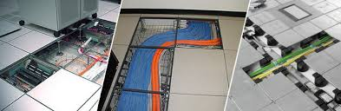
Data Center Wiring

Slide 10
Personnel Access Controls
Facility
Turnstiles
Man traps
Guards
Identification
Photo IDs
Magnetic ID cards
Biometric devices
CCTV
IP Cameras

Slide 11
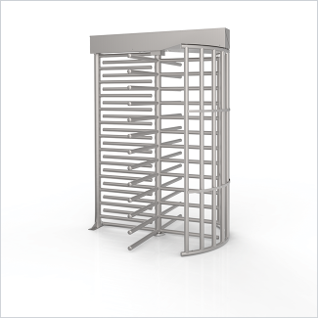
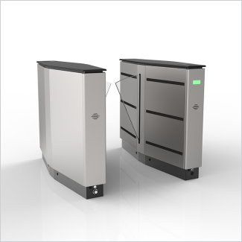
Turnstiles

Slide 12
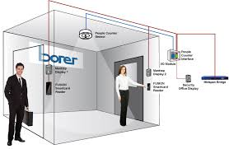
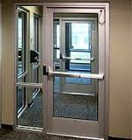
Mantraps

Slide 13
Personnel Access Controls
Proximity Readers
User Activated – User swipes card, system lets person in
System Sensing – Sensor can detect badges in proximity to sensor
Two-factor (or multi-factor):
Proximity reader /numeric keypad
Hand geometry reader w/proximity or keypad or both
Card badge readers
Transponders - Card and Reader have receiver, transmitter, and battery
Passive Devices - Device is powered by reader

Slide 14
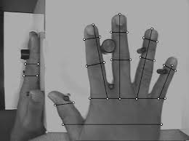
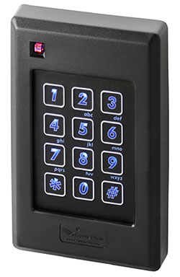
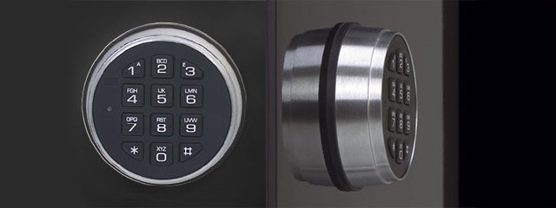
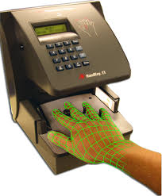
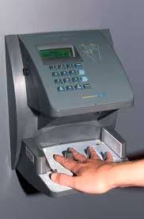
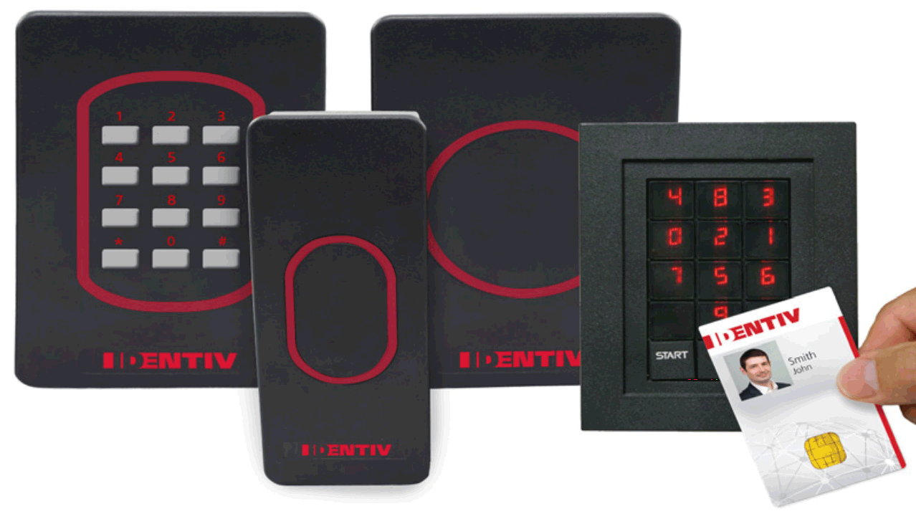
Bio / 2-factor Access Controls

Slide 15

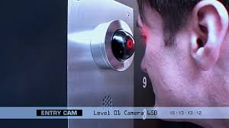
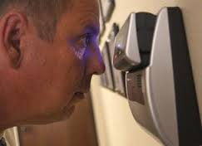

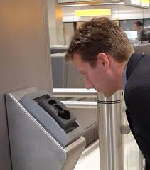
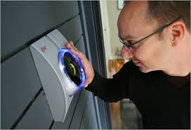
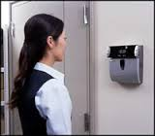
Iris & Retina Scanning

Slide 16
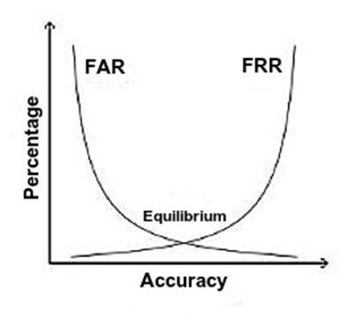
Biometric Accuracy
False Reject Rate (FRR)
Type I error – rejects valid user
False Accept Rate (FAR)
Type II error – allows invalid user
Crossover Error Rate (CER)
Measurement between FRR and FAR
Lower CER means a more accurate biometric system

Slide 17
Auditing Physical Access
Processes & Logs (lots and lots of logs!)
Date/time
Location
ID(s) used
Access logs are a detective tool, not preventative!

Slide 18
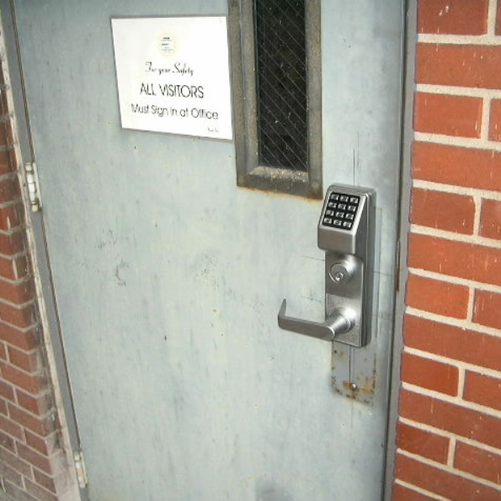
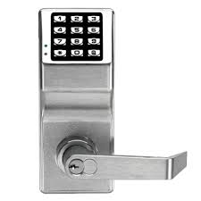
Cipher Locks (What’s wrong with the picture on the right?)

Slide 19
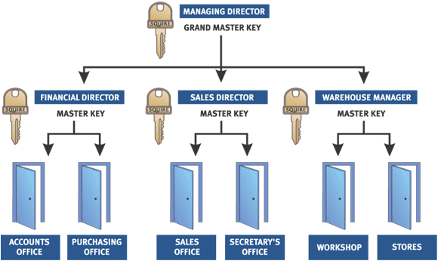
Master Keying

Slide 20
External Boundary Protection
Fencing & other physical barriers
Lighting
Intrusion detection
CCTV / IP Cameras
Patrol Force

Slide 21
Fencing
Varying heights provide varying levels of protection
3 -4 ft /1meter (deters casual trespasser)
6 -7 ft/2meters (too high to climb easily)
8 ft/2.4meters + 3 strands of barbed wire (deter determined intruder)
Grades of Fence
Wire gauge (lower number = larger, heavier wire)
Mesh size (2 in normal, 3/8 in is highest security)
Can be costly
May be unsightly, zoning considerations
Perimeter Intrusion Detection and Assessment System (PIDAS) can detect cutting or climbing

Slide 22
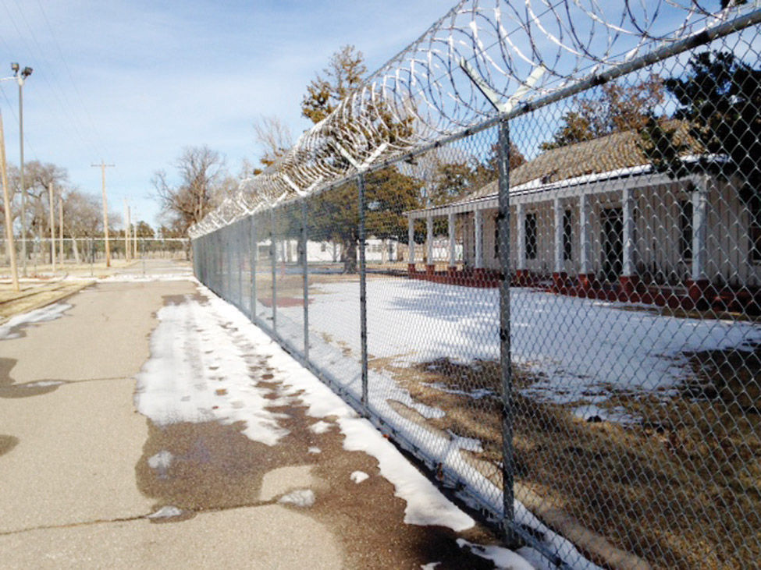
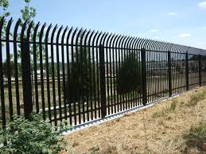
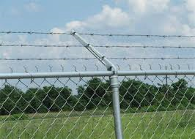
Fence Examples

Slide 23
Other Physical Barriers
Landscaping
Shrubs can provide an alternative to fencing
However tall trees can provide a shelter for intruders
Gates
A movable barrier
Entrapment – Condition where an object could get caught that may result in injury
Bollards / Vehicle (Physical) Barriers
Heavy duty post to restrict vehicle traffic

Slide 24
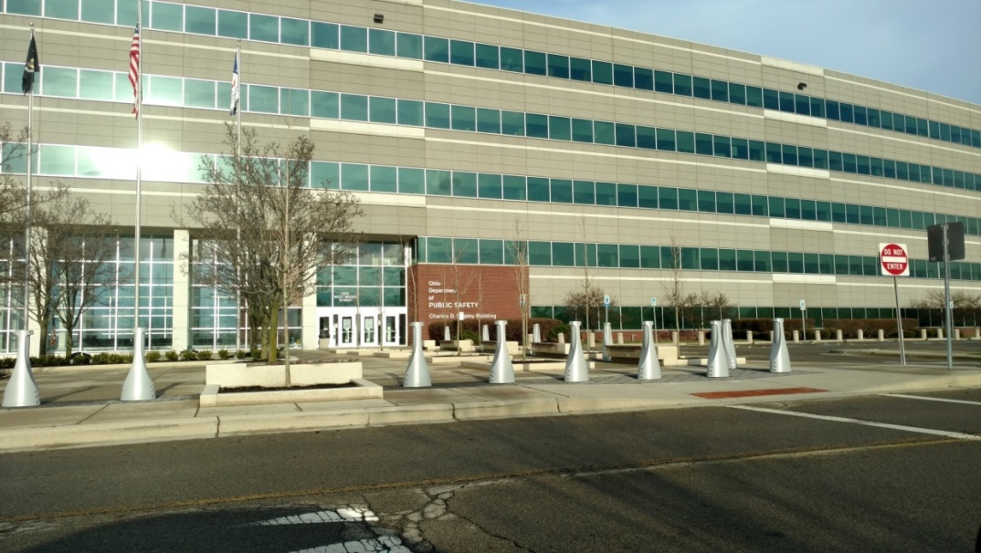
Physical Barriers / Bollards

Slide 25
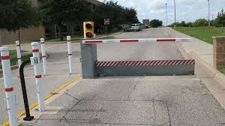
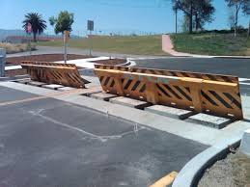
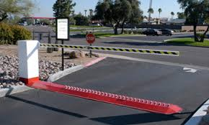
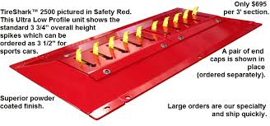
Other Vehicle Barriers

Slide 26
‘K' rating Crash Test Certification
A ‘K' rating is a Crash Test Certification issued by the Department of State (DoS) to a fence, gate, barrier or bollard indicating the perpendicular impact penetration of a vehicle of a specific weight at a specific speed. In other words, it measures the particular stopping power of a barrier in relation to the speed and weight of an incoming vehicle. The K-rating weight of the vehicle is standard at 15,000 lbs. These DoS standard barriers only allow the truck to penetrate no more than 36 inches past the bed.
K4 rating is for a vehicle traveling 30mph
K8 rating is for a vehicle traveling 40mph
K12 rating is for a vehicle traveling 50mph

Slide 27
Physical Intrusion Detection
Intrusion detection/monitoring
Optical/light beams
Vibration sensors
Closed circuit TV
Motion detection
Infrared
Microwave

Slide 28
Physical Intrusion Detection
Considerations:
Expensive to install and monitor
Requires human response
Practical if fence not possible
Subject to nuisance alarms (false positives)
Can be penetrated

Slide 29
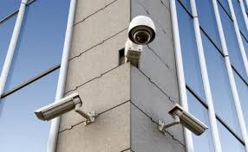
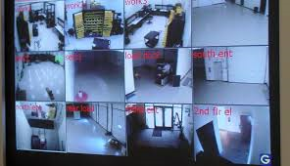
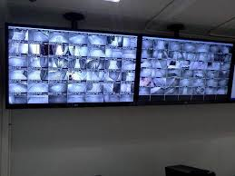
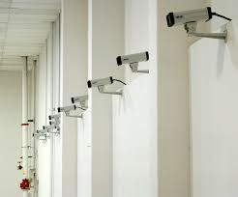
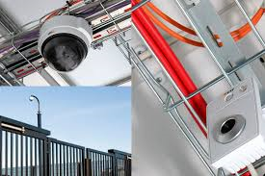
Video Surveillance

Slide 30
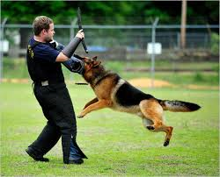
Patrol Forces
Guards
Can provide flexible security & safety response
Good deterrence
May be effective for protecting group of buildings
Costly
Guard Dogs

Slide 31
Types of Alarms
Deterrent: Triggers deterrents such as locks, close doors, etc. – meant to contain or make further intrusion more difficult
Repellant: Sound an audio device, turn on / flash lights, etc. – used to discourage intruders or attackers from continuing or force off premises
Notification: Often silent, notifying others of the event, triggering recording (video, physical location, etc.) – used to bring authorities to the perpetrator in the hopes of catching them
Local System: Broadcast an alarm up to 120db that can be heard up to 400ft away – used to notify security or guards who can respond (similar to repellant)
Central Station: Usually silent locally, but alerting off-site agents who can respond – examples include Brinks, ADT, etc.
Auxiliary Station: Automatic notification added to local or central station – used to alert emergency services such as police, fire, medical, etc. (could result in fees for false alarms)
Combined: Two or more of the alarms can be incorporated in a single solution

Slide 32
Power Terminology
Fault: A momentary loss of power
Blackout: A complete loss of power
Sag: Momentary low voltage
Brownout: Prolonged low voltage
Spike: Momentary high voltage
Surge: Prolonged high voltage
Inrush: An initial surge of power usually associated with connecting to a power source, whether primary or alternative / secondary
Noise: A steady interfering power disturbance or fluctuation
Transient: A short duration of line noise disturbance
Clean: Non-fluctuating pure power
Floating Ground: The wire in an electrical circuit that is grounded

Slide 33
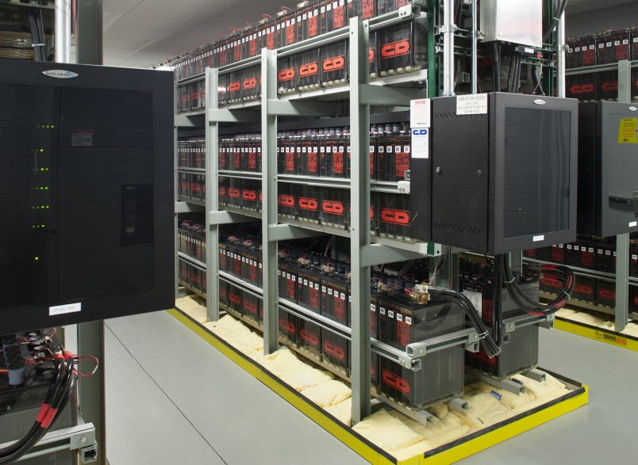
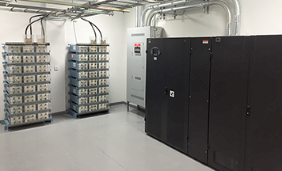
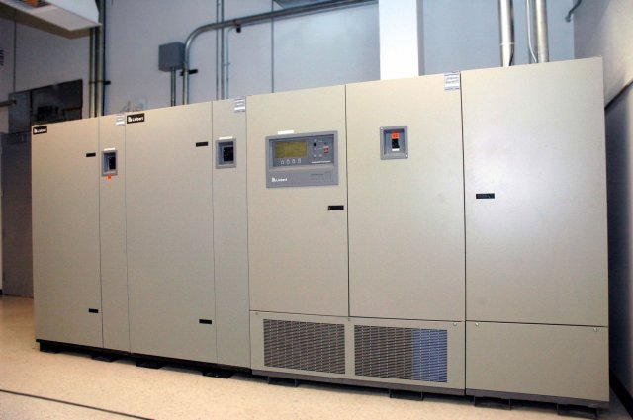
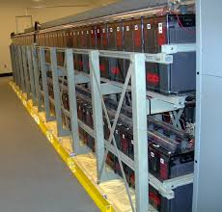
Uninterrupted Power (UPS)

Slide 34
Static voltage damage levels
40: Destruction of sensitive circuits
1,000: Scrambling of monitor displays
1,500: Destruction of data stored on hard drives
2,000: Abrupt system shutdown
4,000: Printer jam or component damage
17,000: Permanent circuit damage

Slide 35
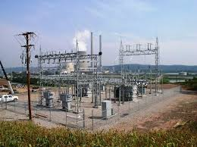
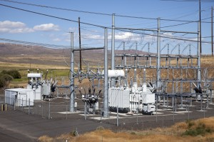
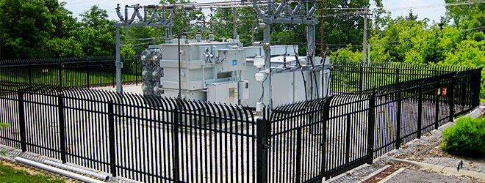
Power sub-stations

Slide 36
HVAC Environmental Conditioning
Freon
Glycol
Water
Positive pressure
What’s the right temperature?

Slide 37
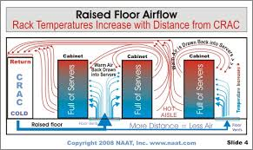
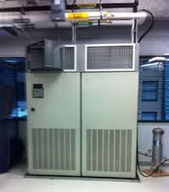
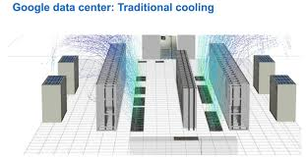
Computer Room Air Conditioners

Slide 38
Fire
Combustion elements
Fuel, Oxygen, Temperature
Suppression methods versus combustion elements
Remove fuel / oxygen (CO2/soda acid)
Reduce temperature (water)
Interference with chemical reaction (Halon)

Slide 39
Fire Suppression - Classes
A - Common combustibles
Suppress with water/soda acid
B - Liquid
Suppress with CO2/soda acid/Halon (Dry Chemical)
C -Electrical
Suppress with CO2/Halon (Dry Chemical)
D –Combustible Materials (Magnesium, Sodium, Potassium)
Dry Powder (NaCl, Graphite, Cu)
K – Cooking oils and fats (Grease)

Slide 40
Fire Suppression Agents
Water
Bad for electronics and buildings
CO2
colorless, odorless, and potentially lethal in that it removes oxygen
Bad for people
Use built-in delay in manned areas
Emergency shut off override
Halon
Better for people
Bad for environment (Ozone-depleting)
Use built-in delay in manned areas
Emergency shut off override

Slide 41
Halon
Halogenated extinguishing agent
Must be thoroughly mixed with air
Montreal protocol (1987)
stopped Halon production as of 01/01/94 due to agent releasing ozone-depleting substances
Halon 1301 requires expensive pressurized flooding system
Halon 1211 self-pressurizes (used in portable extinguishers)
FM-200 most effective alternative to Halon
Other Alternatives are NAFS-III, CEA-410, FE-13, Argon, Water, Inergon, or Argonite

Slide 42
Types of systems
Wet pipe
Always contain water
Discharged by temperature control sensors
Could cause damage in the event of a pipe break
Dry pipe
Water is not in the pipe until a temperature is reached
Typically a delay between detection and release of water
Pre-action
Combination of Dry and wet pipe
Water is release based on temperature, but sprinkler head doesn’t release water until a link is melted away
Deluge
Dry pipe system with large volumes of water

Slide 43
Fire Detection
Smoke Activated
Photoelectric device detects changes in air particles
Prone to false alarms
Heat activated
Detect heat (fixed-temperature or rate of rise)
Flame activated
Senses the pulsations of flames or infrared flame energy
Expensive

Slide 44
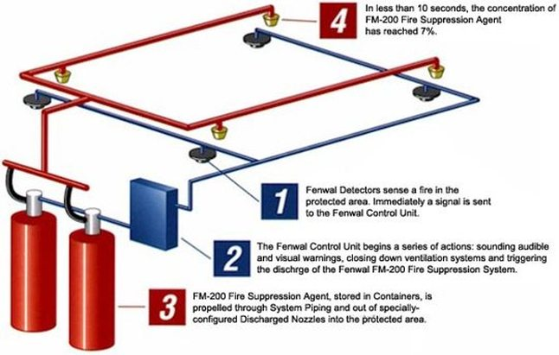
Fire prevention systems

Slide 45



Fire prevention systems

